Slide 1
Lecture 06: C Language

Slide 2
Objectives
Computer program/Memory architecture
Typical C program elements
C statements and comments
Variables and Data types
Variables vs. Constants/Literals
Standard Inputs/Outputs

Slide 3
Computer program
Program is to complete a task when executed on a computer
The computer itself doesn’t know how to complete the task
A programmer must instruct the computer to do the task
And so, programmer need to write codes for the instructions
Computer’s vocabulary only includes 1s and 0s
Programmers can write code in 1s and 0s (punch card) – low level language
Or in high level language (C, C++, Java) and there must be compilers to compile the high level language to machine language

Slide 4
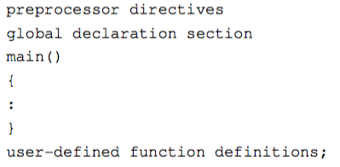
A C Program
Preprocessor directives provide instructions to the preprocessor, to include functions from the system library, to define the symbolic constants and macro.
Every C program must have one main() function. Your application will start from this function.

Slide 5
C statements/comments
Every C statement is terminated with semicolon ‘;’
We could write comments to explain code, and comments will not be executed
Comment a single line with //
Comment a block with /*….......*/

Slide 6
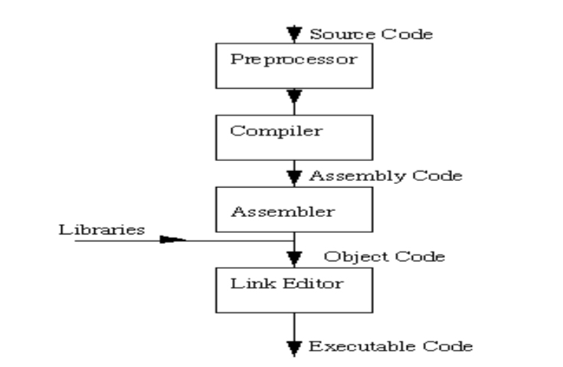
C Compilation model

Slide 7
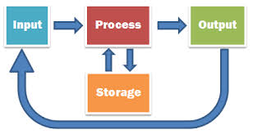
Components of a computer program

Slide 8
Memory
 |  |  |  |  |  |  |  |  |  |  |  |  |  |  |  | 0 | 0 | 0 | 0 | 0 | 0 | 0 | 0
0 | 0 | 0 | 0 | 0 | 0 | 0 | 0 | 0 | 0 | 0 | 0 | 0 | 0 | 0 | 0 | 0 | 0 | 0 | 0 | 0 | 0 | 0 | 0
0 | 0 | 0 | 0 | 0 | 0 | 0 | 0 | 0 | 0 | 0 | 0 | 0 | 0 | 0 | 0 | 0 | 0 | 0 | 0 | 0 | 0 | 0 | 0
0 | 0 | 0 | 0 | 0 | 0 | 0 | 0 | 0 | 0 | 0 | 0 | 0 | 0 | 0 | 0 | 0 | 0 | 1 | 1 | 1 | 0 | 1 | 1
To be able to complete a task, program needs to have the ability to store its data
Program’s data is stored in computer’s memory
Computer Memory stores data in a sequence of bits (each bit can either store 0 or 1)
Even though the smallest unit is a bit, smallest usable unit in memory is a byte
Each byte (8 bits) in the memory has an unique location (its counting index)

Slide 9
Variable
name
 |  |  |  |  |  |  |  |  |  |  |  |  |  |  |  | 0 | 0 | 0 | 0 | 0 | 0 | 0 | 0
0 | 0 | 0 | 0 | 0 | 0 | 0 | 0 | 0 | 0 | 0 | 0 | 0 | 0 | 0 | 0 | 0 | 0 | 0 | 0 | 0 | 0 | 0 | 0
0 | 0 | 0 | 0 | 0 | 0 | 0 | 0 | 0 | 0 | 0 | 0 | 0 | 0 | 0 | 0 | 0 | 0 | 0 | 0 | 0 | 0 | 0 | 0
0 | 0 | 0 | 0 | 0 | 0 | 0 | 0 | 0 | 0 | 0 | 0 | 0 | 0 | 0 | 0 | 0 | 0 | 1 | 1 | 1 | 0 | 1 | 1
Memory location
Provides meaningful name for a location in memory
Is a location in the memory where value is stored and can be retrieved later
Variable must be declared before it can be used

Slide 10
Variable
Variable
Data
Variable is used to store data

Slide 11
Variable
Data
Variable
Data
Variable is used to store data
“Variable” means it could store different data at different time

Slide 12
Constants/Literals
Constants refer to fixed values
These fixed values are also called literals
E.g.,
Integer constants: 1, 2, 3,…
Floating constants: 1.1, 2.3, 4.0,...
Character constants: ‘a’, ‘b’, ‘c’,…
String literals: “Hello, there”, “Hi, there”, ...
Variables are used to hold constant values
But at different time it can hold different constant values

Slide 13
Data types
Variable must have a data type, which specifies
Which kind of data it can contain
Size of data to be stored in the memory (bytes)
How to convert from them from/to binary format
Data types can be divided into
Primitive data types e.g., int, float double, etc.
Reference data types e.g., array, pointer, etc.

Slide 14
Data Types
variable
Data
Data

Slide 15
Variable declaration
Before using a variable, we need to declare it
Declaring a variable:
The name of the variable is preceded with the data type
The name should follow naming conventions
No white spaces, special characters (*, !, ?, etc.)
Could include underscore (‘_’)
Could include digits (but not at the start of the name)
Etc.,

Slide 16
Basic data types
int
Size: 4 bytes
E.g., 1, 2, 3, etc.
float
Size: 4 bytes
E.g., 1.1, 1.2, etc.
double
Size: 8 bytes
E.g., 1.234, 2.3, etc.
Basic data types
char
Size: 1 byte
E.g., ‘a’, ‘b, ‘c’, etc.
Usage: datatype varName;
E.g., int x;
E.g., with initialization
int x = 10;
void

Slide 17
Type int
Stores numeric data
Cannot store other type e.g., “Alan” or “abc”
Declaration: int num;
Size (Depends on the Operating System)
Normally 32 bits (4 bytes)
Integers in the range: -32768 to 32767
Examples: 12322, 0, -232

Slide 18
Type float
Stores values containing decimal places
Cannot store other type e.g., “Alan” or “abc”
Precision of up to 6 digits
Declaration: float num;
Size (Depends on the Operating System)
Normally 32 bits (4 bytes)
Examples: 12.1, 14.5, 15

Slide 19
Type double
Stores values containing decimal places
Cannot store other type e.g., “Alan” or “abc”
Precision of up to 10 digits
Declaration: double num;
Size (Depends on the Operating System)
Normally 64 bits (8 bytes)
Examples: 15.0, 2.456, 1245

Slide 20
Type char
Stores single character information
Cannot store other type e.g., “Alan” or “abc”
Declaration: char c;
Size (Depends on the Operating System)
Normally 8 bits (1 byte)
Examples: ‘a’, ‘b’, ‘$’, ‘%’, ‘1’, ‘2’

Slide 21
Type void
Stores nothing
This is used to indicate the compiler that there is nothing to expect

Slide 22
Derived data types
Data type
Modifiers
Basic Data
types
Derived data type
unsigned
int
unsigned int
(Permits only positive numbers)
short
int
short int
(Occupies less memory space)
long
int/double
Long int /long double
(Occupies more space)

Slide 23
Data types and their range
Type | Approximate Size in Bits | Minimal Range
char | 8 | -128 to 127
unsigned | 8 | 0 to 255
signed char | 8 | -128 to 127
int | 16 | -32,768 to 32,767
unsigned int | 16 | 0 to 65,535
signed int | 16 | Same as int
short int | 8 | -128 to 127
unsigned short int | 8 | 0 to 255
The size of data type depends Operating System
sizeof(data type) function returns the size of data type

Slide 24
Data types and their range
Type | Approximate Size in Bits | Minimal Range
signed short int | 8 | Same as short int
long int | 32 | -2,147,483,647 to 2,147,483,647
signed long int | 32 | Same as long int
unsigned long int | 32 | 0 to 4,294,967,295
float | 32 | Six digits of precision
double | 64 | Ten digits of precision
long double | 128 | Ten digits of precision

Slide 25
Variable initialization
You could initialize values to variables at the time of declaring them
Usage: datatype varName = value;

Slide 26
Activity
Declare a variable for each of the following data types and initialize each with a value
char
int
float
double
long
short

Slide 27
Type casting
An expression can be forced to be of a certain type by using a cast
The general syntax of cast
dataType varName = (dataType)expression
Example
float x, y;
y=45.6;
int i = (int)y;
x = (int)y;//Value of x will be 45

Slide 28
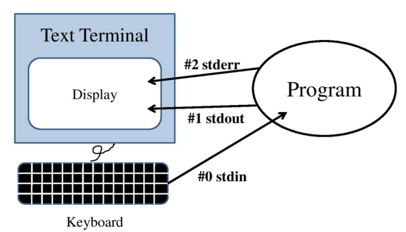
Standard I/O

Slide 29
Standard I/O
Its functions are to handle inputs, outputs, and errors
Standard input is usually from keyboard
Standard output is usually the monitor (via console, or terminal)
Error is normally output to the monitor (via console, or terminal)

Slide 30

Standard output (basics)
The printf(“”, value) function allows the user to write values of various types
To use the printf method, you need to have the #include <stdio.h> preprocessor directive
Hello
Usage, example:
printf(“Hello”);
Or: printf(“%d”, value);

Slide 31
Standard Input (basics)
The scanf(“”, &var) function allows the user to read values of various types
To use the scanf method, you need to have the #include <stdio.h> preprocessor directive
Usage, example:
int x;
scanf(“%d”, &x);

Slide 32
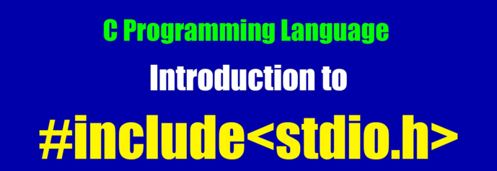
The header file stdio.h
#include<stdio.h> is a preprocessor directive
stdio.h is the header file
It contains macros for many I/O functions
printf(), scanf(), putch(), getch(), puts(), gets() functions require the macros in stdio.h

Slide 33
printf()
To display data on the standard output console (terminal)
Syntax:
printf(“control string”, argument list);
Argument list consists of constants, variables, expressions or functions separated by comas
Control String consists of
Text characters
Format commands: % sign + format code
Special characters: \\, \”, %%

Slide 34
Format codes
Format | printf() | scanf()
Single Character | %c | %c
String | %s | %s
Signed decimal integer | %d | %d
Floating point (decimal notation) | %f | %f or %e
Floating point (decimal notation) | %lf | %lf
Floating point (exponential notation) | %e | %f or %e
Floating point ( %f or %e , whichever is shorter) | %g
Unsigned decimal integer | %u | %u
Unsigned hexadecimal integer (uses “ABCDEF”) | %x | %x
Unsigned octal integer | %o | %o

Slide 35
Special characters
They are meta characters (used to represent about other characters)
\\ | to print \ character
\ “ | to print “ character
%% | to print % character

Slide 36
Activity: printf example
#include <stdio.h>
void main()
{
int a = 10;
float b = 24.67892345;
char ch = ‘A’;
printf(“Integer data = %d”, a);
printf(“Float Data = %f”,b);
printf(“Character = %c”,ch);
printf(“This prints the string”);
printf(“%s”,”This also prints a string”);
}

Slide 37
printf modifiers
Field width modifier
It’s an integer, defines minimum field with for displaying the data
Alignment modifier (‘-’)
The item will be printed beginning from the leftmost position of its field
Precision modifier
It indicates the maximum number of digits to be printed after the floating point
Zero padding modifier (‘0’)
Used to pad ‘0’ to values if there are more space for its displaying field (field width)

Slide 38
printf modifiers
Long Modifier (‘l’)
Used to display long integer or double precision argument (“%ld”)
Short modifier (‘h’)
Used to display short integers (“%hd”).
‘*’ Modifier
Used as a place holder to match with an argument in an order in which they occur
E.g., printf(“%*.2f”, 20, 55.0)
‘*’ will be replaced with 20 (first argument for *) so it becomes printf(“%20.2f”, 55.0) -> displays: 55.00

Slide 39
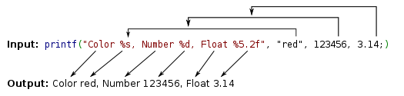
Activity
Example from Wikipedia

Slide 40
Activity: Example for modifiers
/* This program demonstrate the use of Modifiers in printf() */
#include <stdio.h>
void main()
{
printf(“The number 555 in various forms:\n”);
printf(“Without any modifier: \n”);
printf(“[%d]\n”,555);
printf(“With – modifier :\n”);
printf(“[%-d]\n”,555);
printf(“With digit string 10 as modifier :\n”);
printf(“[%10d]\n”,555);
printf(“With 0 as modifier : \n”);
printf(“[%0d]\n”,555);
printf(“With 0 and digit string 10 as modifiers :\n”);
printf(“[%010d]\n”,555);
printf(“With -, 0 and digit string 10 as modifiers: \n”);
printf(“[%-010d]\n”,555);
}

Slide 41
scanf()
Used to accept data from standard Input
General format of scanf() function
scanf(“control string”, arg. list)
The format codes used in printf()are the same as in the scanf(), with some notices
 | printf() | scanf()
Argument list | uses variable names, constants, symbolic constants and expressions | uses pointers to variables
%g | Yes | No
%f and %e | Are different | Are the same

Slide 42
Activity: scanf()/printf()
Make a request to ask user to input
2 numbers a & b of type int
Then display greeting message to the user using the input name/age
Welcome to C class, sum of [a] & [b] is [sum].

Slide 43
Character input and output
getchar()
Accepts single character from input stream stdin (keyboard buffer)
Usage: char c = getchar();
putchar()
This function displays a single character to the standard output (stdout), monitor
Usage: putchar(c);

Slide 44
String input and output
gets()
Accepts a string terminated by a new line
Usage: gets(stringvariable);
String is represented as array of characters
E.g., char ch[5]; gets(ch);
puts()
Displays the string in the standard output
Usage: puts(str);

Slide 45
Activity
Ask user to input his/her name
Display greeting message to the person
E.g.,
Please input your name: Mr. A
Welcome Mr. A to Procedural Programming!
In which, Mr. A is the user input value

Slide 46
Summaries
Computer program/Memory architecture
Typical C program elements
C statements and comments
Variables and Data types
Variables vs. Constants/Literals
Standard Inputs/Outputs

